Slide 1
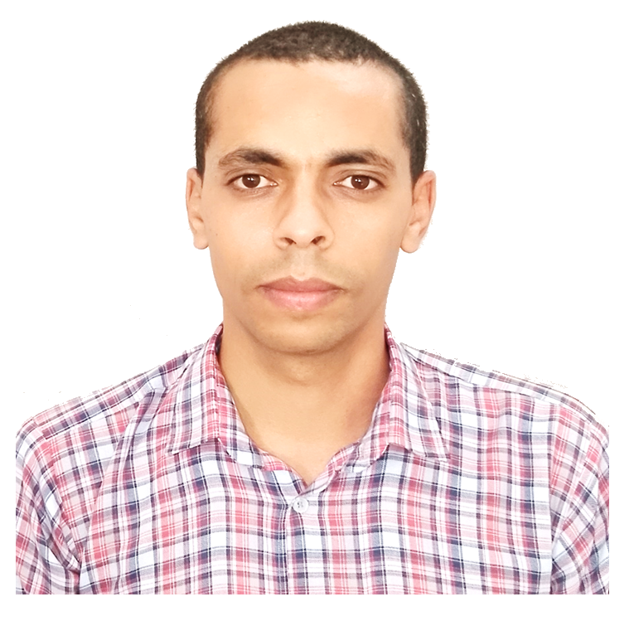













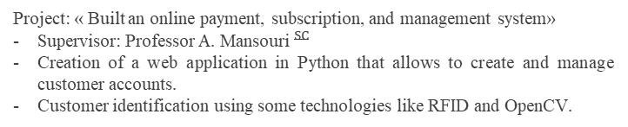
SAID ABENNA
PhD in Electrical Engineering at Hassan II University
EDUCATION
CONTACT
PhD in Dept of Electrical Engineering, Hassan II University, Casablanca.
Dec 2018 – Mar 2023
+212 680402812
MSc in Intelligent and Communicating Systems, Mohammed Ben Abdellah University, Fez.
Sep 2016 – Jul 2018
LinkedIn/Said-Abenna
BSc in Electronic, Sultan Moulay Slimane University, Beni-Mellal.
Sep 2012 – Jul 2016
ResearchGate/Said-Abenna
EXPERIENCE
dr.said.abenna@gmail.com
Project
Feb 2024
Foum-Zaouia, Taghzirt, 23652, Beni-Mellal
Sujet: «YanSOQ - Real-Time Earth Simulator Based on New Technologies»
Websites: https://yansoq.ct.ws https://yansoq.kesug.com, https://sinsoq.kesug.com;
Operating System: Android, Windows, Linux ;
Publishers: Uptodown, Apkpure, Amazon.
LANGUAGE
Arabic Fluent
English Professional
French Professional
Teaching at FST-Mohamedia, :
Sep 2020 – Jun 2022
Electricity Tutoring Project at for: MIP-S2 in 2020, BCG-S1 in 2021, and MIP-S1 in 2022.
DESKTOP
Internship at JWAY-Morocco
Feb 2018 – May 2018
Project: « Built an online payment, subscription, and management system»
Supervisor: Professor ${\text{A}\text{.} \text{Mansouri} }^{SC}$
Creation of a web application in Python that allows to create and manage customer accounts.
Customer identification using some technologies like RFID and OpenCV.
Microsoft Office
Latex
Photoshop
Filmora
Git
THESIS
Topic:
Electroencephalography-based Brain-Computer Interface: Embedding a Command-Control for Intelligent Systems by Detection and Modeling of Brain Activities
SKILLS
Defence:
The February 25, 2023.
Languages: Python (TensorFlow, OpenCV, PyTorch, SQLite, NLTK, PyQt, Kivy, Flask), C/C++, Vhdl, Java, C#, HTML/ JavaScript.
Supervisor:
Mr. Mohammed NAHID, Professor (PH) at FSTM, UH2, Casablanca.
Co-Supervisor:
Mr. Hamid BOUYGHF, Professor (PA) at FSTM, UH2, Casablanca.
Softwares: Matlab, Arduino, VisualStudio, Linux, Prolog, MikroC, Modelsim. MicroWind, Proteus, Blender, Unity3D, QuartusII, Labview, ADS, Atoll, HFSS, GNS3, ZBrush.
President:
Mr. Abdelhadi RAIHANI, Professeur (PES) at ENSETM, UH2, Casablanca.
Reporters:
Mr. Abdennaceur BAGHDAD, Professor (PES) at FSTM, UH2,
Casablanca;
Mr. Ahmed ABBOU, Professor (PES) at EMI, UM5, Rabat;
Mr. Youssef FAKHRI, Professor (PES) at FS, UIT, Kenitra.
Examiner:
Mr. Abderrahim BAJIT, Professor (PH) at ENSA, UIT, Kenitra.
Chips: ATMEGA328PU, FPGA.
Highlights:
Build of an EEG Signals Acquisition System;
Build of EEG Signals Frequency and Spatial Processing System;
Build of a Self-Optimized Classification System using ML/DL/MH Algos;
Embedding of a Real-Time Mental Tasks Prediction System;
Design of a 3D City for Virtual Control using C#/Blender/Unity3D/Python;
Build of a Human Body Motions Detection System using Python.
Style: Independent, Versatile, Adaptive, In-Team, Organized, Leadership.

Slide 2


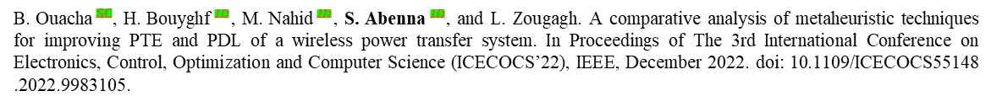
PUBLICATIONS
${\text{B}\text{. }\text{Ouacha} }^{SC}$, ${\text{H}\text{. }\text{Bouyghf} }^{ID}$, ${\text{M}\text{. }\text{Nahid} }^{ID}$, and ${\text{S}\text{. }\text{Abenna} }^{ID}$. Design and miniaturization of a microsystem to power biomedical implants using Grey Wolf Optimizer-Based Cuckoo Search Algorithm”. International Journal of Power Electronics and Drive System, 13(2) :1329-1337, April 2023. ISSN 2088-8694. doi : 10.11591/ijece.v13i2.pp1329-1337.
${\text{S}\text{. }\text{Abenna} }^{ID}$, ${\text{M}\text{. }\text{Nahid} }^{ID}$, ${\text{H}\text{. }\text{Bouyghf} }^{ID}$, and ${\text{B}\text{. }\text{Ouacha} }^{SC}$. An enhanced motor imagery EEG signals prediction system in real-time based on delta rhythm. Biomedical Signal Processing and Control, 79, January 2023. doi : 10.1016/j.bspc.2022.104210.
${\text{B}\text{. }\text{Ouacha} }^{SC}$, ${\text{H}\text{. }\text{Bouyghf} }^{ID}$, ${\text{M}\text{. }\text{Nahid} }^{ID}$, ${\text{S}\text{. }\text{Abenna} }^{ID}$, and L. Zougagh. A comparative analysis of metaheuristic techniques for improving PTE and PDL of a wireless power transfer system. In Proceedings of The 3rd International Conference on Electronics, Control, Optimization and Computer Science (ICECOCS’22), IEEE, December 2022. doi: 10.1109/ICECOCS55148 .2022.9983105.
${\text{S}\text{. }\text{Abenna} }^{ID}$, ${\text{M}\text{. }\text{Nahid} }^{ID}$, ${\text{H}\text{. }\text{Bouyghf} }^{ID}$, and ${\text{B}\text{. }\text{Ouacha} }^{SC}$. EEG-based BCI : a novel improvement for EEG signals classification based on real-time preprocessing. Computers in Biology and Medicine, 148(2022), August 2022. doi : 10.1016/j.compbiomed.2022.105931.
${\text{B}\text{. }\text{Ouacha} }^{SC}$, ${\text{H}\text{. }\text{Bouyghf} }^{ID}$, ${\text{M}\text{. }\text{Nahid} }^{ID}$, and ${\text{S}\text{. }\text{Abenna} }^{ID}$. DEA-based on optimization of inductive coupling for powering implantable biomedical devices. International Journal of Power Electronics and Drive System, 13(3) :1558-1567, September 2022. ISSN 2088-8694. doi : 10.11591/ijpeds.v13.i3.pp1558-1567.
${\text{S}\text{. }\text{Abenna} }^{ID}$, ${\text{M}\text{. }\text{Nahid} }^{ID}$, and ${\text{A}\text{. }\text{Bajit} }^{ID}$. A novel EEG classification for baseline motor cortex using adaboost. In Proceedings of the 2nd International Conference on Big Data, Modelling and Machine Learning – BML, pages 125-129. INSTICC, SciTePress, 2022. ISBN 978-989-758-559-3. doi : 10.5220/0010729600003101.
${\text{S}\text{. }\text{Abenna} }^{ID}$, ${\text{M}\text{. }\text{Nahid} }^{ID}$, and ${\text{H}\text{. }\text{Bouyghf} }^{ID}$. An enhanced EEG prediction system for motor cortex-imagery tasks using SVM. E3S Web of Conferences, 351 :01026, 2022. doi : 10.1051/e3sconf/202235101026.
${\text{S}\text{. }\text{Abenna} }^{ID}$, ${\text{M}\text{. }\text{Nahid} }^{ID}$, and ${\text{H}\text{. }\text{Bouyghf} }^{ID}$. Alcohol use disorders automatic detection based BCI systems : A novel EEG classification based on machine learning and optimization algorithms. International Journal of Information Science and Technology, 6(1) :14-25, February 2022. ISSN 2550-5114. doi: 10.57675/IMIST.PRSM/ijist-v6i1.178.
${\text{S}\text{. }\text{Abenna} }^{ID}$, ${\text{M}\text{. }\text{Nahid} }^{ID}$, and ${\text{H}\text{. }\text{Bouyghf} }^{ID}$. Sleep Stages Detection Based BCI : A Novel Single-Channel EEG Classification Based on Optimized Bandpass Filter, volume 110, chapter 10, pages 96-105. Springer, Cham, 2022. ISBN 978-3-030-94187-1 ; 978-3-030-94188-8. doi : 10.1007/978-3-030-94188-8_10.
${\text{S}\text{. }\text{Abenna} }^{ID}$, ${\text{M}\text{. }\text{Nahid} }^{ID}$, and ${\text{A}\text{. }\text{Bajit} }^{ID}$. Motor imagery based brain-computer interface : improving the EEG classification using delta rhythm and lightgbm algorithm. Biomedical Signal Processing and Control, 71(11), January 2022. doi : 10.1016/j.bspc.2021.103102.
${\text{S}\text{. }\text{Abenna} }^{ID}$, ${\text{M}\text{. }\text{Nahid} }^{ID}$, and ${\text{A}\text{. }\text{Bajit} }^{ID}$. Brain-computer interface : A novel EEG classification for baseline eye states using LGBM algorithm, volume 211, chapter 18, pages 189-198. Springer Science and Business Media LLC, 2021. ISBN 978-3-030-73882-2. doi : 10.1007/978-3-030-73882-2_18.
${\text{S}\text{. }\text{Abenna} }^{ID}$, ${\text{M}\text{. }\text{Nahid} }^{ID}$, and ${\text{A}\text{. }\text{Bajit} }^{ID}$. BCI : Classifiers Optimization for EEG Signals Acquiring in Real-Time. In The 6th IEEE Congress on Information Science and Technology (CiSt), IEEE, 2021. doi : 10.1109/CiSt4939 9.2021.9357209.
${\text{S}\text{. }\text{Abenna} }^{ID}$, ${\text{M}\text{. }\text{Nahid} }^{ID}$, and ${\text{A}\text{. }\text{K}\text{. }\text{Belbachir}}^{SC}$. Brain-computer interface : Rhythm alpha analysis for eyes signals. In The Fourth International Conference On Intelligent Computing in Data Sciences, IEEE, 2020. doi : 10.1109/ICDS50568.2020.9268719.
COMMUNICATIONS
The 7th International Conference on Wireless Technologies, Embedded and Intelligent Systems, Fez, Morocco: An enhanced EEG prediction system for motor cortex-imagery tasks using SVM. S. Abenna, M. Nahid, and H. Bouyghf., March 2022.
The 3th International Conference on Advanced Technologies for Humanity, Rabat, Morocco: Sleep Stages Detection Based BCI : A Novel Single-Channel EEG Classification Based on Optimized Bandpass Filter. S. Abenna, M. Nahid, and H. Bouyghf., November 2021.
The 2nd International Conference on Big Data, Modelling and Machine Learning, Kenitra, Morocco: A novel EEG classification for baseline motor cortex using adaboost. S. Abenna, M. Nahid, and A. Bajit., July 2021.
The First International Conference on Digital Technologies and Applications, Fez, Morocco: Brain-computer interface : A novel EEG classification for baseline eye states using LGBM algorithm. S. Abenna, M. Nahid, and A. Bajit., January 2021.
The 4th International Conference On Intelligent Computing in Data Sciences, Fez, Morocco : Brain-computer interface : Rhythm alpha analysis for eyes signals. S. Abenna, M. Nahid, and A. K. Belbachir., October 2020.

Slide 3


COMPLETED ACADEMIC PROJECTS
Initiative Research Project, Two Months, ENSAF:
2017
Topic:
Study of Cybernetic Systems and Cryptography Algorithms
Complementary Project, Two Months, ENSAF:
2017
Topic:
Study of a Microwave Band-Pass Filter
Bachelor-Final Project, Three Months, FPBM:
2015
Topic:
Analysis and Processing of Electrocardiogram Signals
OTHER FORMATIONS
Coursera : IoT, AI, Management, and Law; (Certificates in LinkedIn)
2021-2022
Clarivate Analytics: Web of Science Seminar
2019

